Slide 1
Realized Eschatology?
The AD 70 Doctrine
(part 6 continued)

Slide 2
Corruption of the END OF THE WORLD
Section 3

Slide 3
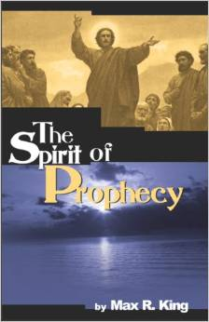
“The world marked for destruction in prophecy, the end of which involved the second coming of Christ and resulted in the true redemption of Israel, was the Jewish world. Therefore it is the end of the Jewish world and not this material earth we live on today.”
(King, The Spirit of Prophecy, p. 83)

Slide 4

EXAMPLE:
“Heavens and earth = Israel”
  Deuteronomy 31:30
    “Then Moses spoke in the hearing of all the assembly of Israel the words of this song until they were ended:”
  Deuteronomy 32:1
    “Give ear, O heavens, and I will speak; And hear, O earth, the words of my mouth.”
Therefore 2 Peter 3:5 = Destruction of Israel

Slide 5
Deuteronomy 32:1
THE TRUTH:
Heaven’s and Earth are invoked by Moses as witnesses against Israel (Deut. 31:28)
Most of the time false teachers are defeated by the very passages they parade
Format of Deuteronomy parallels the prevailing practice of suzerain-vassal treaties (Hittites 1400-1200 BC)

Slide 6
Deuteronomy Format Ignored By Realized Eschatologists
Preamble (Deut. 1:1-5)
Historical prologue (Deut. 1:6-4:49)
Laws (Deut. 5-26)
  General (5-11)
  Specific (12-26)
Blessings and curses (Deut. 27-28)
Witnesses
  Heavens and earth (4:26; 30:19; 31:28)
  Moses’ song (31:19, 21)
  The Book of the Law (31:26)

Slide 7
Deuteronomy 32:1
THE TRUTH:
Even if the “heavens and earth” consisted of Israel in Deuteronomy 32:1, it does not mean that is the correct definition for 2 Peter 3!
Why not “laid hands” in Deuteronomy 34:9 taken to Acts 19:6?

Slide 8
Did
THE WORLD END
In AD 70?
Reasons why 2 Peter 3:1-13 does not refer to the destruction of Jerusalem

Slide 9
1. The original recipients were unaffected by Jerusalem’s fall
2 Peter 3:1,
“Beloved, I now write to you this second epistle (in both of which I stir up your pure minds by way of reminder)”
1 Peter 1:1,
“Peter, an apostle of Jesus Christ, To the pilgrims of the Dispersion in Pontus, Galatia, Cappadocia, Asia, and Bithynia”

Slide 10
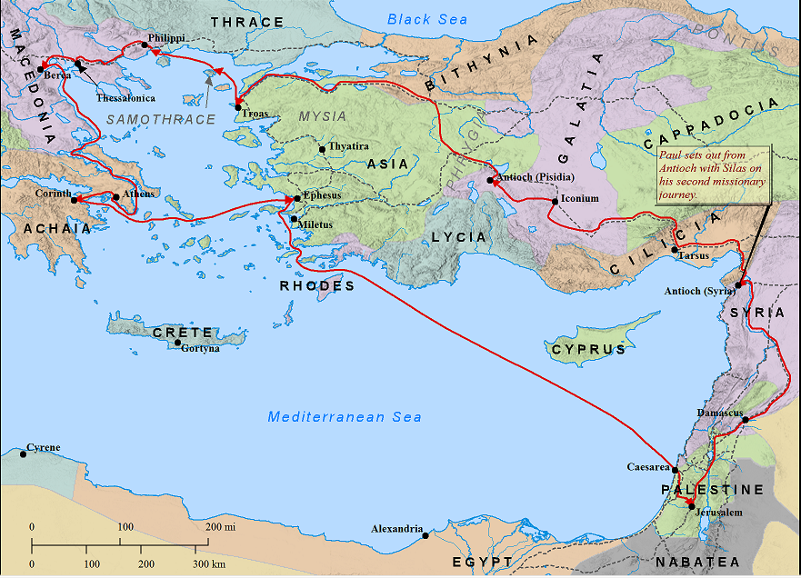
The recipients of 1 &2 Peter
Destruction of Jerusalem

Slide 11
2. We Live In The Description Of The Time Before The End!
Are there scoffers mocking the creation today?
  2 Peter 3:1-4
Are there those who are willfully ignorant of the flood of Noah today?
  2 Peter 3:5, 6
If the world ended in AD 70, why did the scoffing continue?

Slide 12
3. The relationship between the flood and the end is LITERAL
Did Peter accept and teach a literal Noah?
  1 Peter 3:20,
  “who formerly were disobedient, when once the Divine longsuffering waited in the days of Noah, while the ark was being prepared, in which a few, that is, eight souls, were saved through water.”

Slide 13
3. The relationship between the flood and the end is LITERAL
Did Peter teach and accept a literal flood?
  1 Peter 3:20
  2 Peter 2:5,
  “and did not spare the ancient world, but saved Noah, one of eight people, a preacher of righteousness, bringing in the flood on the world of the ungodly;”
  Flood as literal as the ashes of Sodom (2:6)

Slide 14
3. The relationship between the flood and the end is LITERAL
2 Peter 3:5, 6 are only teaching what Peter has previously taught
  “For this they willfully forget: that by the word of God the heavens were of old, and the earth standing out of water and in the water, by which the world that then existed perished, being flooded with water.”
  Genesis 7:1ff

Slide 15
3. The relationship between the flood and the end is LITERAL
“the world that then existed perished” (3:6)
“But the heavens and the earth which are now” (3:7)
If Literal
This Is Literal

Slide 16
3. The relationship between the flood and the end is LITERAL
“being flooded with water” (3:6)
“are reserved for fire” (3:7)
If Literal
This Is Literal

Slide 17
The Proper Correlation
The world that then existed
By the word of God stood out of water
Perished, being flooded with water
The world that then existed
By the word of God stood out of water
Perished, being flooded with water
The heavens and earth which are now
Preserved by the same word
Are reserved for fire
  Pass away with great noise
  Elements will melt with fervent heat
  Earth and works burned
The heavens and earth which are now
Preserved by the same word
Are reserved for fire
  Pass away with great noise
  Elements will melt with fervent heat
  Earth and works burned
If literal, this is literal

Slide 18
4. The way the end comes
2 Peter 3:10,
“But the day of the Lord will come as a thief in the night, in which the heavens will pass away with a great noise, and the elements will melt with fervent heat; both the earth and the works that are in it will be burned up.
Jerusalem was not destroyed as a thief but had signs preceding its fall (Lk. 21:20, 21; Mk. 13:14; Matt. 24:14-16)

Slide 19
Don’t Be Caught SLEEPING!
Mt 24:43 , “But know this, that if the master of the house had known what hour the thief would come, he would have watched and not allowed his house to be broken into.”
1 Thessalonians 5:1-5
“Therefore, beloved, looking forward to these things, be diligent to be found by Him in peace, without spot and blameless” (2 Pet. 3:14)

Slide 20
Do You Have Your Reservations Made?
“Blessed be the God and Father of our Lord Jesus Christ, who according to His abundant mercy has begotten us again to a living hope through the resurrection of Jesus Christ from the dead, to an inheritance incorruptible and undefiled and that does not fade away, reserved in heaven for you”
(1 Pet. 1:3, 4)

Slide 21
Do You Have Your Reservations Made?
“There is also an antitype which now saves us—baptism (not the removal of the filth of the flesh, but the answer of a good conscience toward God), through the resurrection of Jesus Christ, who has gone into heaven and is at the right hand of God, angels and authorities and powers having been made subject to Him” (1 Pet. 3:21, 22)

